Slide 1
Phishing awareness training
Name : SIDDHART MANOJ SHAH

Slide 2

Contents:-
Introduction
About Phishing attacks
Scenario of phishing
Type of phishing attacks
Phishing Examples
Prevention from phishing attacks
Conclusion

Slide 3

Introduction
Phishing is act of attempting to acquire information such as username , password and credit card details as a trustworthy entity in an electronic communication.

Slide 4

About Phishing attacks
It is a from of social engineering and scam where attacker deceive people into revealing sensitive information or installing malware such as ransomware.
It occurs when an attacker, masquerading as a trusted entity, dupe a victim into opening an email , instant message or text message .

Slide 5
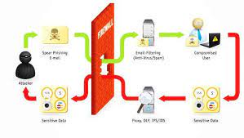
Scenario of phishing

Slide 6
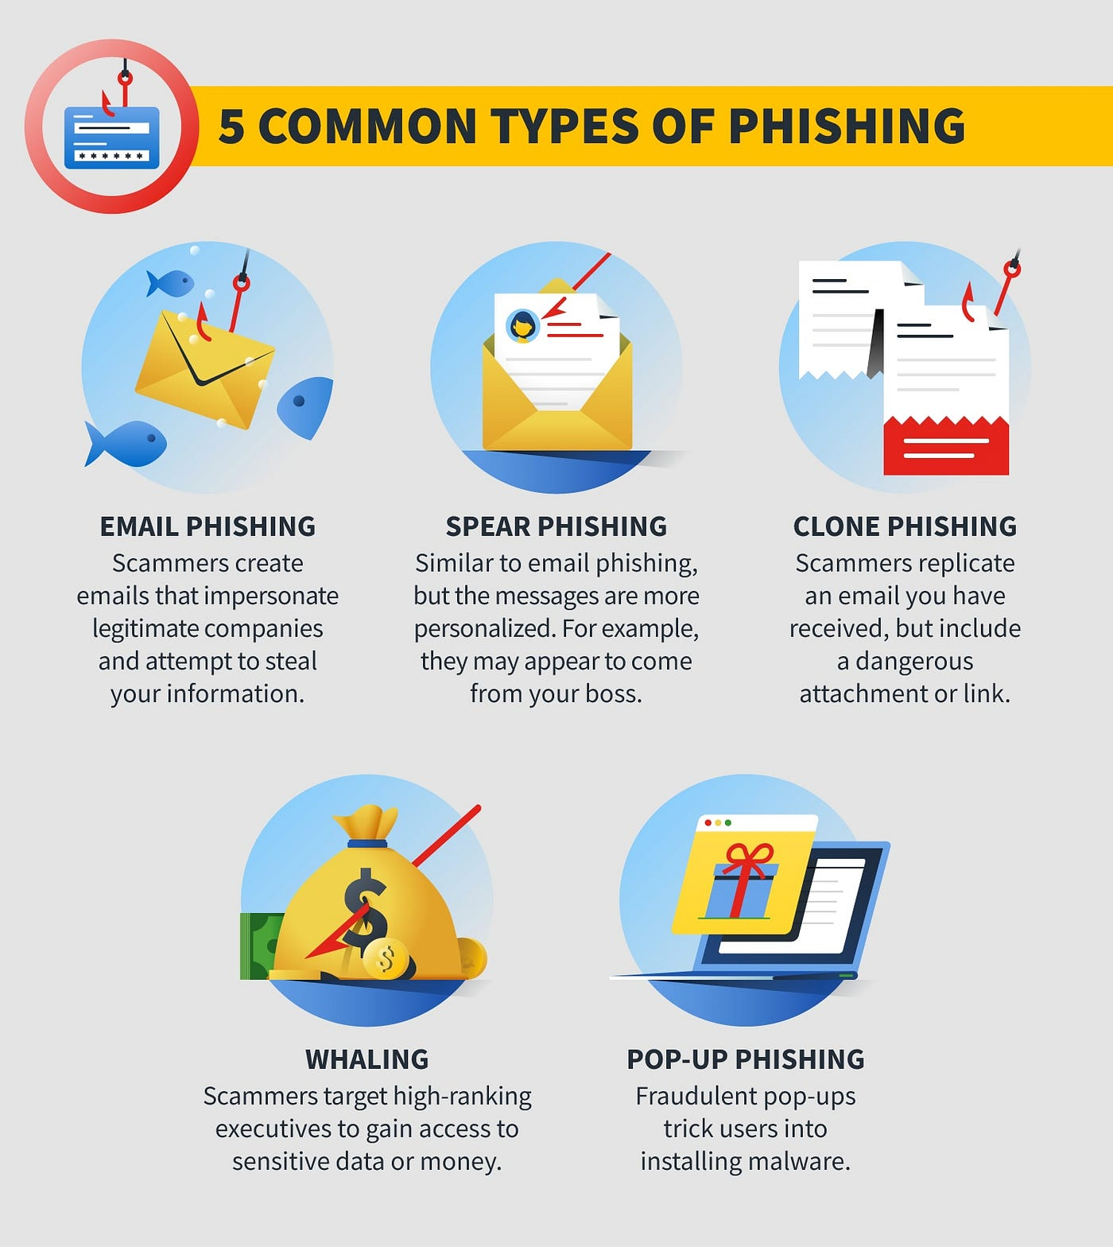
Type of phishing attacks

Slide 7
Phishing Examples
One in 99 email is a phishing attacks , and roughly 90% of data breaches occurs on account of phishing .
71% of all companies experienced a successful phishing attack in 2023.

Slide 8

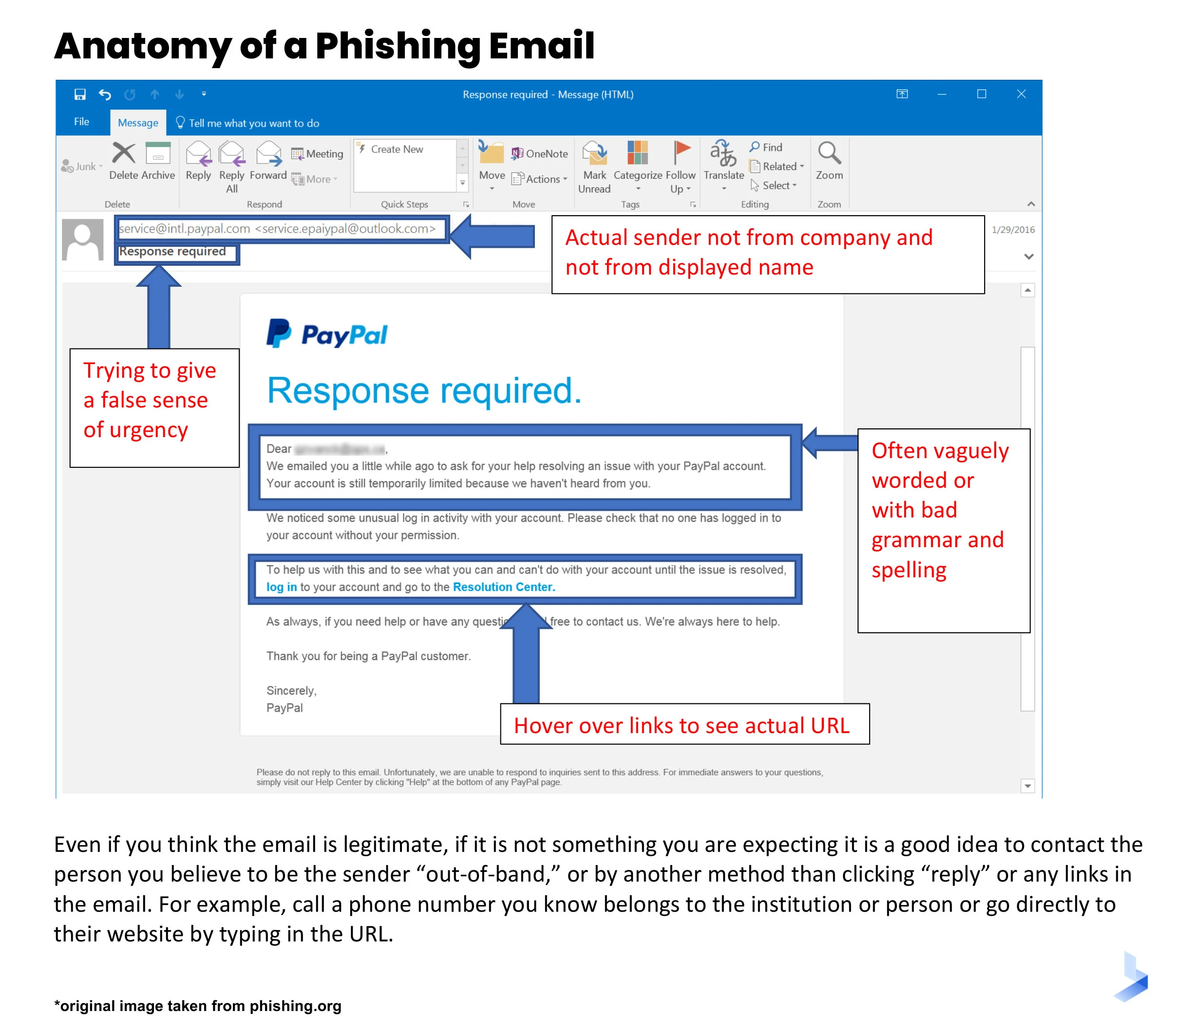
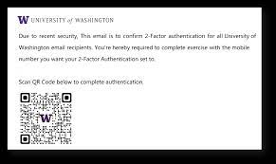

Slide 9

Prevention from phishing attacks
Know what a phishing scam looks like .
Avoid Getting free anti-phishing add-ons.
Utilize end to end encryption.
Conduct simulated phishing attacks test.
Using antivirus and cloud email security solutions.
Using dedication anti phishing solution.
Use security software and tools.

Slide 10

Conclusion
Phishing will never be completely eradicated.
However, a combination of good organization and practice , improvement in security technology has the potential to
drastically reduce the prevalence of
phishing and the losses suffered
from it .

Slide 11

Thank you

